Slide 1
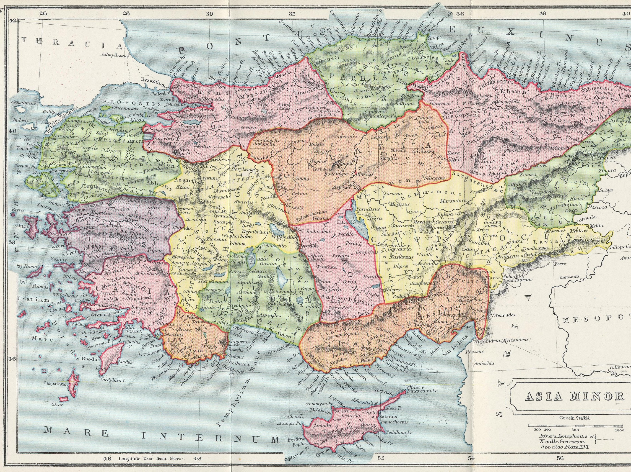
Bithynia
Pontus
Asia
Galatia
Cappadocia
1 Peter 4.1-11
Map from www.annourbis.com

Slide 2
1 Peter 4.1-2 NET: So, since Christ suffered in the flesh, you also arm yourselves with the same attitude, because the one who has suffered in the flesh has finished with sin, ²in that he spends the rest of his time on earth concerned about the will of God and not human desires.

Slide 3
1 Peter 4.1-2 NET: So, since Christ suffered in the flesh, you also arm yourselves with the same attitude, because the one who has suffered in the flesh has finished with sin, ²in that he spends the rest of his time on earth concerned about the will of God and not human desires.

Slide 4
4.3-4: For the time that has passed was sufficient for you to do what the non-Christians desire. You lived then in debauchery, evil desires, drunkenness, carousing, drinking bouts, and wanton idolatries. ⁴So they are astonished when you do not rush with them into the same flood of wickedness, and they vilify you.

Slide 5
4.3-4: For the time that has passed was sufficient for you to do what the non-Christians desire. You lived then in debauchery, evil desires, drunkenness, carousing, drinking bouts, and wanton idolatries. ⁴So they are astonished when you do not rush with them into the same flood of wickedness, and they vilify you.

Slide 6
4.3-4: For the time that has passed was sufficient for you to do what the non-Christians desire. You lived then in debauchery, evil desires, drunkenness, carousing, drinking bouts, and wanton idolatries. ⁴So they are astonished when you do not rush with them into the same flood of wickedness, and they vilify you.

Slide 7
4.5-6: So they are astonished when you do not rush with them into the same flood of wickedness, and they vilify you. ⁵They will face a reckoning before Jesus Christ who stands ready to judge the living and the dead. ⁶Now it was for this very purpose that the gospel was preached to those who are now dead, so that though they were judged in the flesh by human standards they may live spiritually by God's standards.

Slide 8
4.5-6: So they are astonished when you do not rush with them into the same flood of wickedness, and they vilify you. ⁵They will face a reckoning before Jesus Christ who stands ready to judge the living and the dead. ⁶Now it was for this very purpose that the gospel was preached to those who are now dead, so that though they were judged in the flesh by human standards they may live spiritually by God's standards.

Slide 9
4.7-9: For the culmination of all things is near. So be self-controlled and sober-minded for the sake of prayer. ⁸Above all keep your love for one another fervent, because love covers a multitude of sins. ⁹Show hospitality to one another without complaining.

Slide 10
4.7-9: For the culmination of all things is near. So be self-controlled and sober-minded for the sake of prayer. ⁸Above all keep your love for one another fervent, because love covers a multitude of sins. ⁹Show hospitality to one another without complaining.

Slide 11
4.7-9: For the culmination of all things is near. So be self-controlled and sober-minded for the sake of prayer. ⁸Above all keep your love for one another fervent, because love covers a multitude of sins. ⁹Show hospitality to one another without complaining.

Slide 12
4.7-9: For the culmination of all things is near. So be self-controlled and sober-minded for the sake of prayer. ⁸Above all keep your love for one another fervent, because love covers a multitude of sins. ⁹Show hospitality to one another without complaining.

Slide 13
4.10-11: Just as each one has received a gift, use it to serve one another as good stewards of the varied grace of God. ¹¹Whoever speaks, let it be with God's words. Whoever serves, do so with the strength that God supplies, so that in everything God will be glorified through Jesus Christ. To him belong the glory and the power forever and ever. Amen.

Slide 14
4.10-11: Just as each one has received a gift, use it to serve one another as good stewards of the varied grace of God. ¹¹ Whoever speaks, let it be with God's words. Whoever serves, do so with the strength that God supplies, so that in everything God will be glorified through Jesus Christ. To him belong the glory and the power forever and ever. Amen.

Slide 15
4.10-11: Just as each one has received a gift, use it to serve one another as good stewards of the varied grace of God. ¹¹Whoever speaks, let it be with God's words. Whoever serves, do so with the strength that God supplies, so that in everything God will be glorified through Jesus Christ. To him belong the glory and the power forever and ever. Amen.

Slide 16
Bithynia
Pontus
Asia
Galatia
Cappadocia
1 Peter 4.1-11
Map from www.annourbis.com

